Slide 1

London Housing Market

Slide 2
Capstone Project - The Battle of Neighborhoods (Week 2)
Description of the problem and a discussion of the background
According to Bloomberg News, the London Housing Market is in down term due to the COVID 19. It is now facing a number of different difficulties including the prospect of higher taxes and a warning from the Bank of England that U.K. home values could fall as much as 30 percent after exiting from the European Union. More specifically, four overlooked cracks suggest that the London market may be in worse shape than many realize: hidden price falls, record-low sales, homebuilder exodus and tax hikes addressing overseas buyers of homes in England and Wales.
In this scenario, it is important for home buyer to adapt some data analysis to make wise and best decision. In the other world we need to build a model to recommend profitable decision to home buyers and investors based on the available data.

Slide 3
Data on London properties and the relative price paid data were extracted from the
HM Land Registry (http://landregistry.data.gov.uk/). The following fields comprise the address data in: Postalcode; PAON Primary Addressable Object Name. Typically the house number or name; SAON Secondary Addressable Object Name. If there is a sub-building, for example, the building is divided into flats, there will be a SAON; Street; Locality; Town/City; District; County.

Slide 4
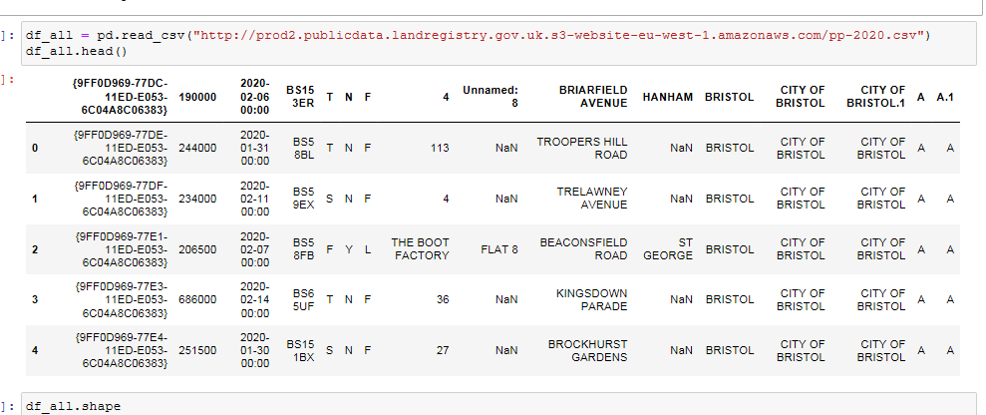
Below is A DATA FRAME WE USED

Slide 5
To explore and target recommended locations across different venues according to the presence of amenities and essential facilities, we will access data through FourSquare API interface and arrange them as a data frame for visualization. By merging data on London properties and the relative price paid data from the HM Land Registry and data on amenities and essential facilities surrounding such properties from FourSquare API interface, we will be able to recommend profitable real estate investments.

Slide 6
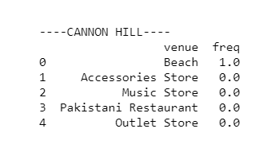
Grouping each Borough

Slide 7
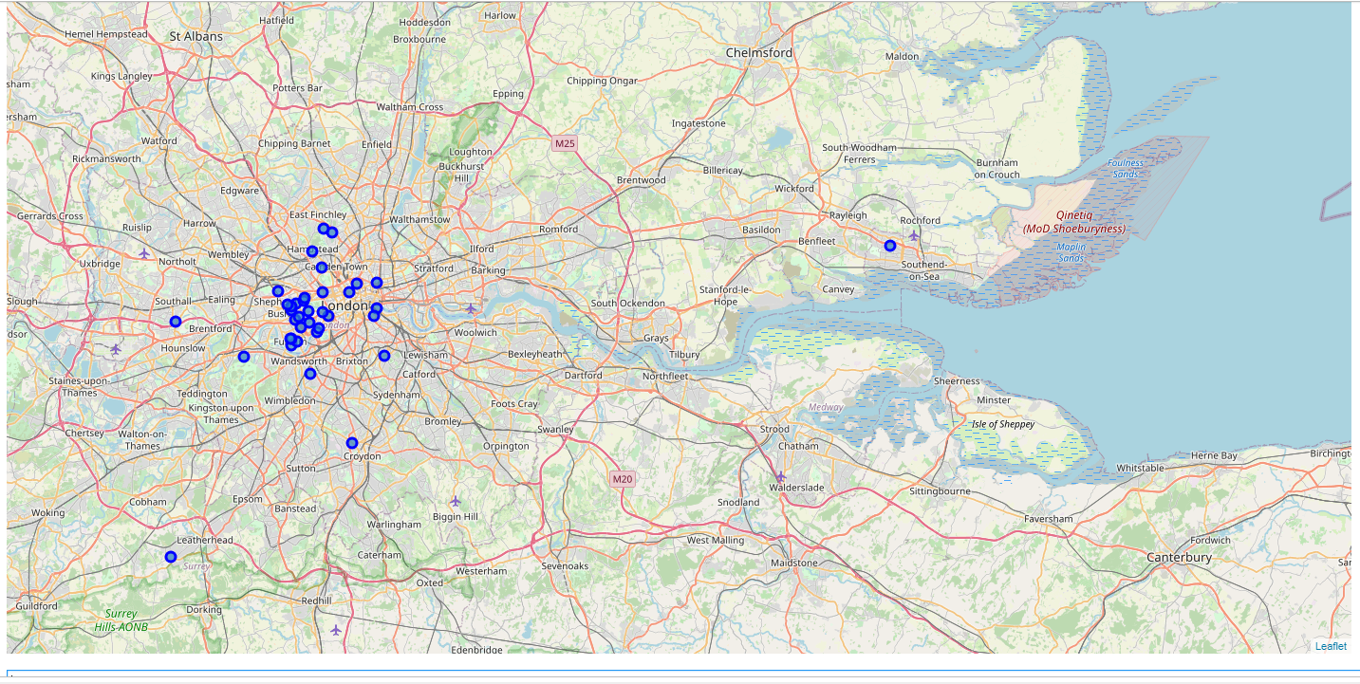
London Map & Clustering

Slide 8
Result from the model
As per our model, it is obvious that although there are some challenges in buying a property in London, there are still opportunities for home buyers and investors to by a property in London.
We can conclude the results under 2 main Categories:
We can examine the neighborhood, it is interesting to note that although west of London is more popular due to the amenities like schools, park,.. but data shows that other part of the city like southwest and northwest also rising and it is a good idea to have an investment on those area too.
We used Kmeans with 5 clusters and it shows that some cluster are more favorable to families due to have amenities like school park, grocery store and so on and some other clusters are favorable for young and singles as on those clusters we have more pubs .

